Slide 1
Presenting research work
How to be a good communicator
Andrew Briasco-Stewart
Xavier Thomas
Anatoly Zavyalov
Portions of this deck are inspired by previous instances of this course (here & here)

Slide 2
Outline
Preparing Your Talk
Public Speaking
Presentation Design
Making Diagrams
Poster Design

Slide 3
Outline
Preparing Your Talk
Public Speaking
Presentation Design
Making Diagrams
Poster Design

Slide 4


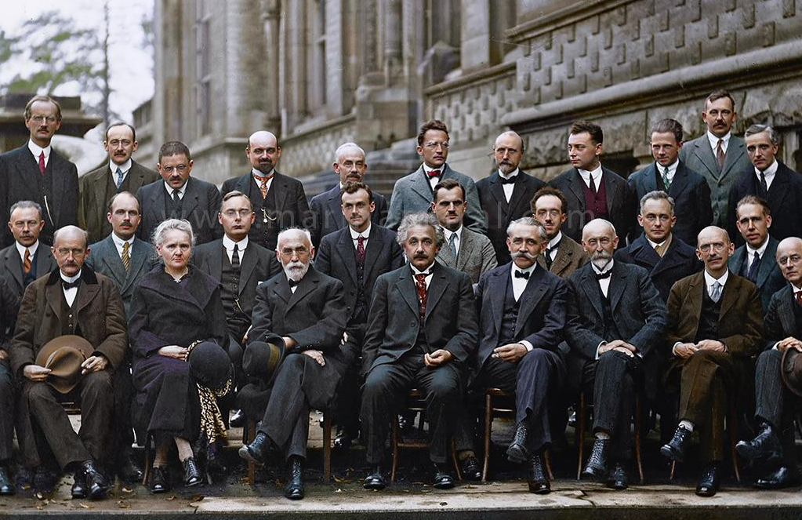
Know your audience.
Structure your presentation with the audience in mind.
What does the audience already know?
Err on side of caution: Better to bore than to confuse.

Slide 5
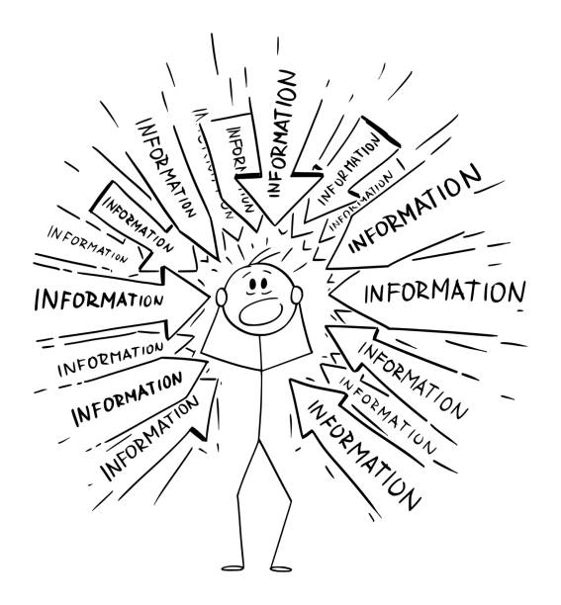
You can’t mention everything.
Your talk is an advertisement and a tutorial to your paper.
Your audience won’t remember everything you say.
If your audience can only remember three ideas from your talk, what should they be?

Slide 6
The fight against time.
Example plan for our talk:
Preparing your talk (5 min)
Public speaking (7 min)
Presentation design (12 min)
Making diagrams (6 min)
Poster design (6 min)
20 minute vs. 60 minute talks are wildly different!
Plan the time you will spend on each section: motivation, results, techniques, experiments, etc.
Spend time proportional to importance, novelty, coolness

Slide 7

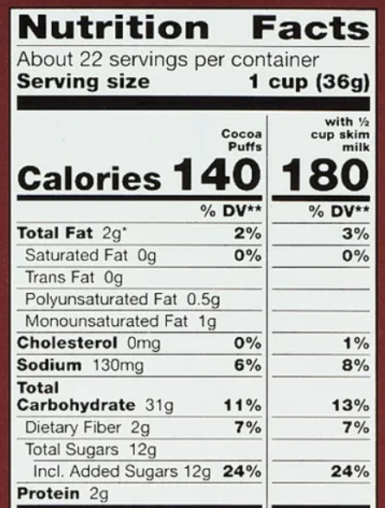
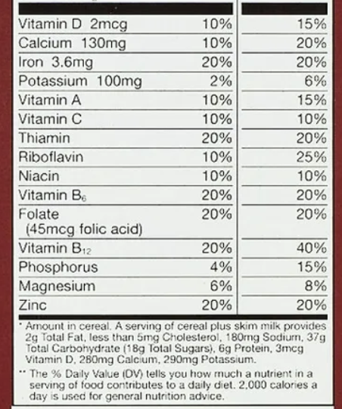
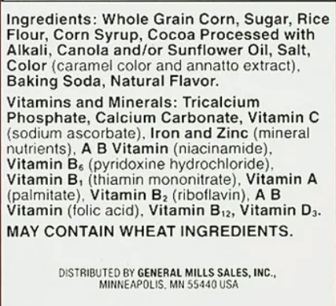
Front of box, back of box
What you want your talk to look like:

Slide 8
Front of box, back of box
What it should actually look like:

Slide 9
Format and time
Preparing your talk, you should know:
How much time you will have
Whether to use slides, board, etc.
Who the audience will be
Different strategy for 20min talk, 40 min talk, etc.
Depends on you -- presentation needs to be tailored to your style. Present it how you would present to your friends

Slide 10
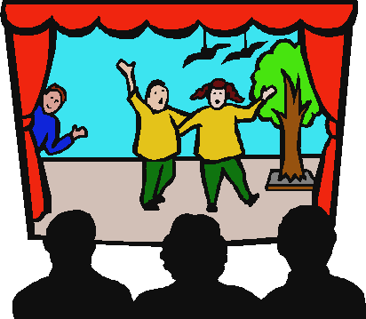
Rehearse!
Time yourself! (Could even record yourself!)
Goal: Be rehearsed without sounding rehearsed
Give practice talks to your advisor, colleagues, or friends

Slide 11
Recap: Preparing your Talk
Any tips for preparing presentations?
Know your audience!
What are the big ideas your audience should take away?
Spend time proportional to novelty and coolness.
Rehearse, rehearse, rehearse!

Slide 12
Outline
Preparing Your Talk
Public Speaking
Presentation Design
Making Diagrams
Poster Design

Slide 13
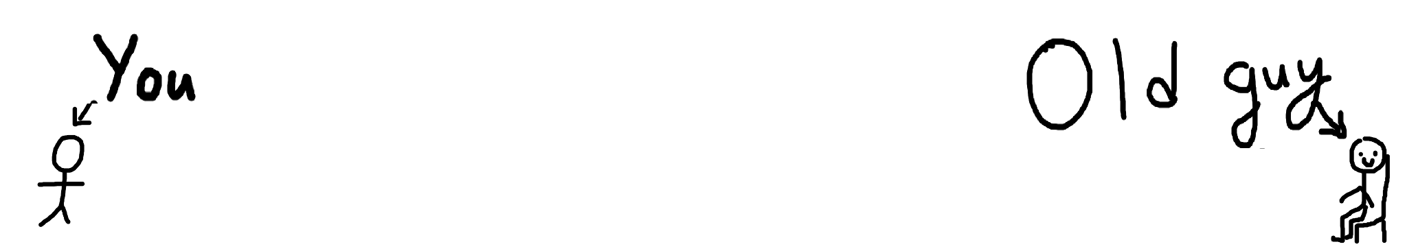
There is a very senile person at the very back.
They can barely see or hear.
They cannot hold more than one train of thought.
They should understand your talk!

Slide 14


Speed of talking
You will be nervous
Talking speed is (somewhat) tied to heart rate
So, talking too slow is just right
Notes:
In most cases, the audience is also looking at you along with the slides your presenting, so what you wear and how you look do impact the presentation.
If you think you’re speaking slightly too slow, you’re probably speaking at the right pace. Talking speed is somewhat tied to heart rate, so when you get nervous there’s a natural tendency to speed up.

Slide 15
The audience is watching you. 👁️👄👁️
Are you also watching the audience?
Eye contact is important.
Scan the audience and look at ALL their beautiful faces.
Be sure to be appropriately dressed and groomed.
Try to be confident: fake it till you make it.

Slide 16
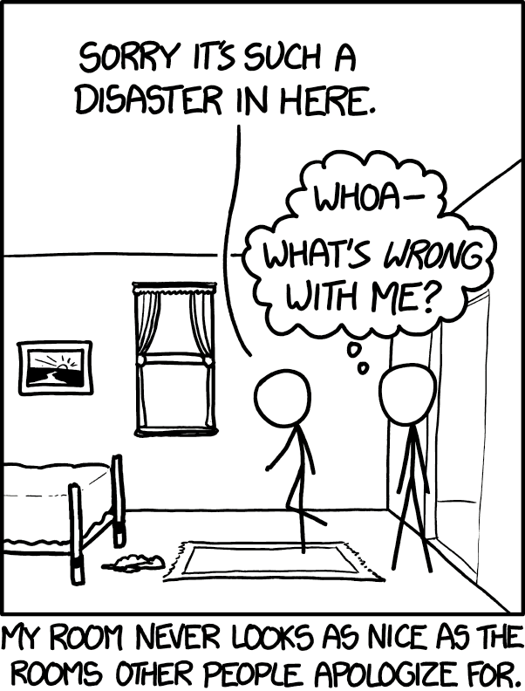
You will probably mess up.
And that’s OK.
You’ll never do as well as in your rehearsals.
No one will remember when you mess up.
Audience doesn’t know the “ideal version” of your talk.

Slide 17
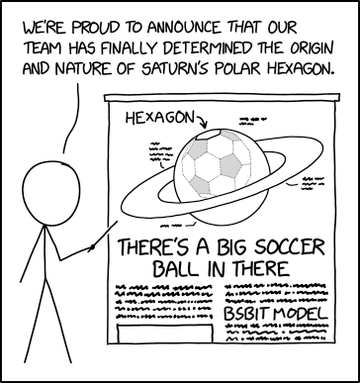
Working with slides and on the board
Don’t read off slides!
Face the audience when speaking!
Don’t cover what you are writing on the board!

Slide 18

Q/A
Always thank a person for their question!
Take a moment to think if you need
It’s ok to say you don’t know: always be truthful
Can always say “Let’s take it offline” :)

Slide 19
other stuff i will put into slides
try to be a bit funny (through
presenting yourself along with presentation
people look at u as much as your slides.
you want to give yourself off as confident and comfortable, well rehearsed but also not scripted
if you think you’re talking too slow when you’re nervous, ur probably talking at right speed.

Slide 20
Public Speaking - Tone, Volume, Speed
You are presenting yourself along with the slides
Tone, Volume, Speed
Talking speed - too slow is just right
Notes:
In most cases, the audience is also looking at you along with the slides your presenting, so what you wear and how you look do impact the presentation.
If you think you’re speaking slightly too slow, you’re probably speaking at the right pace. Talking speed is somewhat tied to heart rate, so when you get nervous there’s a natural tendency to speed up.

Slide 21
Recap: Public Speaking
Any tips for public speaking?
The senile man at the back of the room should be able to understand you!
Talk clearly, face the audience, (try to) appear confident
Don’t read off the slides!
It’s ok to mess up! No one will notice or care.

Slide 22
Outline
Preparing Your Talk
Public Speaking
Presentation Design
Making Diagrams
Poster Design

Slide 23
How to make a slide
not too much on each slide

Slide 24




Medium / Technology
Various software for designing a presentation
powerpoint, google slides, keynote, even latex
Notes:
Various slides for designing a presentation.
May have a requirement if working with someone, but choose the one you’re comfortable with that has the capabilities you need.

Slide 25
Making the Presentation - Outline (1/4)
Put key ideas that cover the narrative
At most one idea per slide
Leave placeholders for figures & images
Notes:
Similar to a paper, start with an outline of the key ideas you want to cover.

Slide 26
Making the Presentation - Filling In (2/4)
Get all the info onto slides, or in speaker notes
Spend some time on formatting, but don’t go crazy
Shortcuts make your life easier - use them!
Don’t be afraid to come back later
Notes:
Fill in details - can essentially practice what you’re going to say, then add important details to the slides
You can spend too much time on formatting here, because if later on you trim or change, that time spent might be wasted

Slide 27
Information on Slides
Don’t put too much text in your slides! Lots of text can derail your ability to tell a story and can cause people to focus on reading the slide as opposed to listening to what you’re saying. The less text the better as viewers can scan it quickly and focus on what you’re saying. Your slides should have plenty of “white space” or “negative space.” If a slide starts to feel “cluttered” then it’s probably a good idea to break it into two slides, or slowly reveal content as you talk. The less clutter you have on your slide, the more powerful your visual message becomes.
Notes:
Now here’s an example of what not to do. As I’m talking right now, a lot of you are probably focused on reading through this slide instead of listening to what I’m saying. People can be single-minded like this, so having as few words on the slide as possible enables the audience to scan it quickly before re-focusing on what you’re saying.

Slide 28
Animations
Use animations where appropriate
Somewhat technology dependent
Careful not to over-do – this isn’t middle school
Can use built-in tools or multiple slides
Notes:
Sometimes dense slides are unavoidable, or you want everything on the same slide for a big picture image. You

Slide 29
power of animations
show a slide with A LOT of text or diagrams or something like some kind of insane construction or model picture.
convey that this is a lot of information for the audience all at once.
Next slide: show the same slide, but reveal bit by bit with animations. point is that this is much more digestible

Slide 30
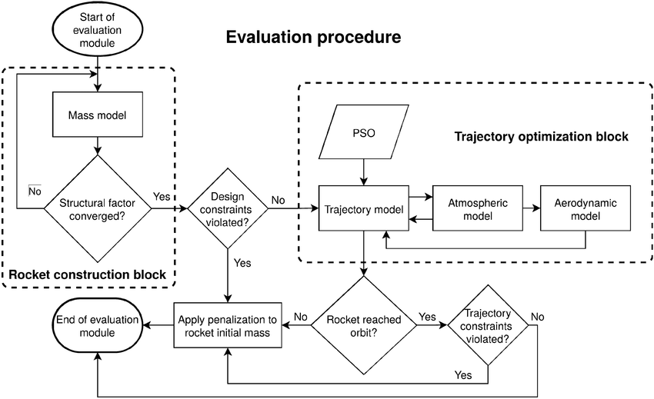

Slide 34



Making the Presentation - Refine & Trim (3/4)
Talk-through / present each slide
Remove unnecessary ink, text, images, bullets
Review overall organization & flow
Hide or move old slides with useful info
Can go back to earlier steps if missed something
Notes:
Depending on constraints, will need to trim. It’s always easier to trim then to expand.
Practice presenting each slide, either out loud or in your head. As you do, make notes of what to change on each slide
Does the story it tell make sense?

Slide 35



Making the Presentation - Practice (4/4)
Practice, Practice, Practice
Alone - in your head or out loud
To friends - context may be tricky if not right audience
Record yourself & review
Q: How do you practice presentations?

Slide 36

Audience Engagement
Should you ask questions during your presentation?

Slide 37

Tips & Tricks
Use presenter view if it makes sense & you are able.
Avoid rapidly cycling through slides - jump instead
Notes:
Presenter view typically needs extended display, not mirrored so it isn’t always possible to use it
If possible, don’t cycle one-by-one back through slides to reference something, scroll and choose the correct one.

Slide 38
Adaptability
What slides can you skip if running behind?
Where do you expect questions?
Where are the natural breaks in the presentation?
Supporting slides?

Slide 39
Board Work
Start with a clean board - no distractions!
Make full use of the board
Good handwriting can only help
Don’t erase things you just wrote
Organize and Leave Space

Slide 40
Recap: Presentation Design
Any tips for presentation design?
Don’t put too much texts on slides
Use animations to hide information
Outline, fill in, refine, practice
Make sure slides are adaptable

Slide 41
Outline
Preparing Your Talk
Public Speaking
Presentation Design
Making Diagrams
Poster Design

Slide 42
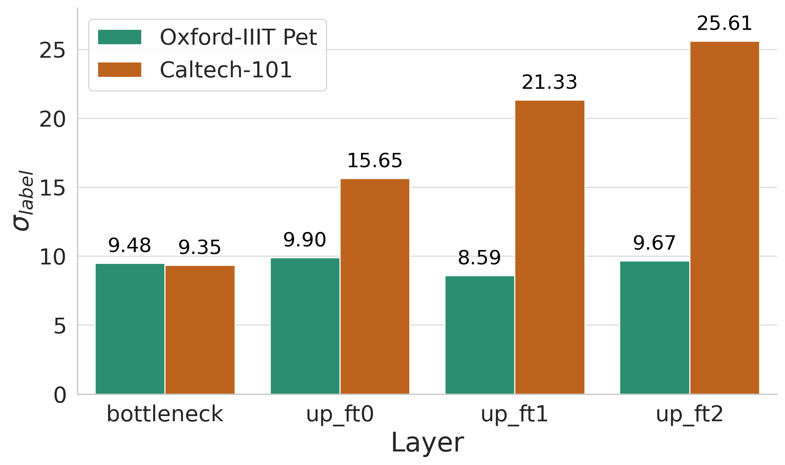
Making a diagram
What is a good diagram?
Easy to digest
Self contained
A diagram exists to reduce thinking effort
If it increases effort, it failed
Cognitive load is the real enemy

Slide 43
Making a diagram
Reduce cognitive load
Datasets used
What questions should a diagram answer? Good starting point: “What should the viewer walk away knowing?”
Take the audience to where you want them to go
Contrast with colors

Slide 44
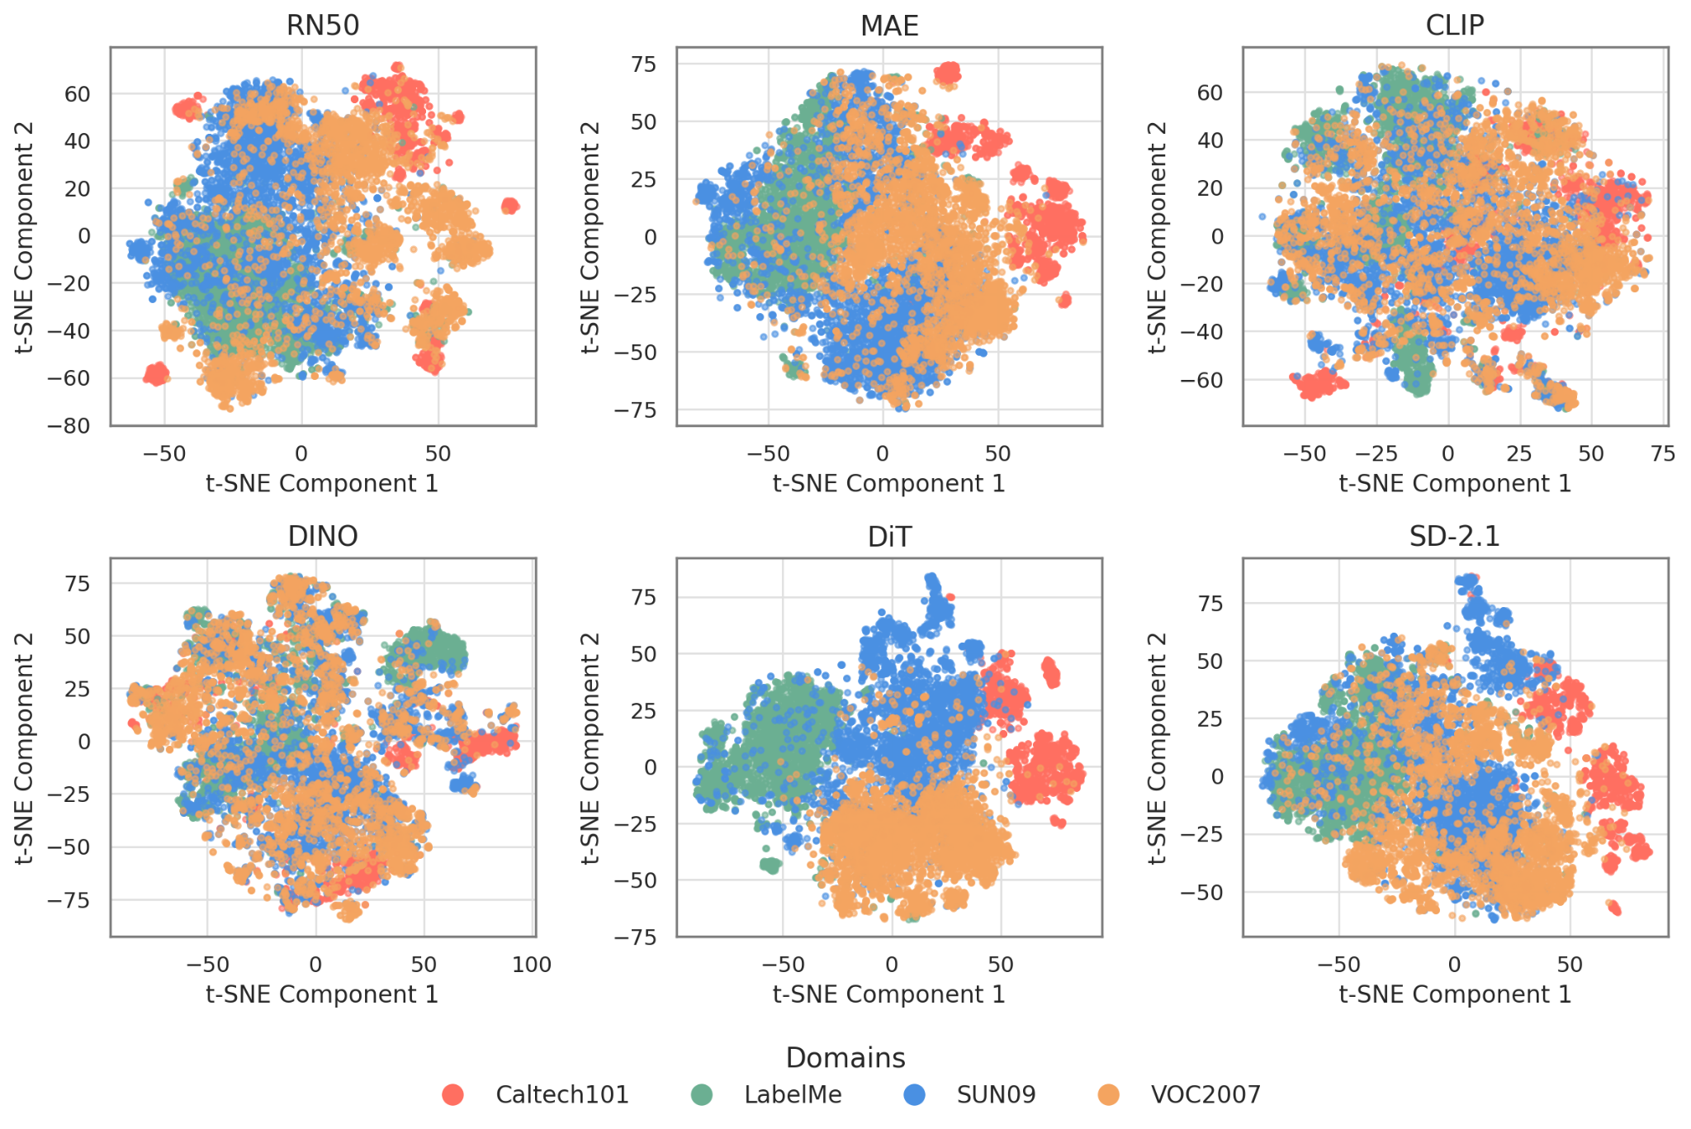
Making a diagram
Question
Answer
Which feature space to use to extract pseudo-domain centroids? - Diffusion Models!
Domain NMI: 0.22
Domain NMI: 0.20
Domain NMI: 0.01
What is a good diagram?
Motivates a question
Provides evidence
Finding: Among all models, DiT achieves the clearest domain separation on the VLCS dataset
Domain NMI: 0.05
Domain NMI: 0.58
Domain NMI: 0.26
Evidence

Slide 45
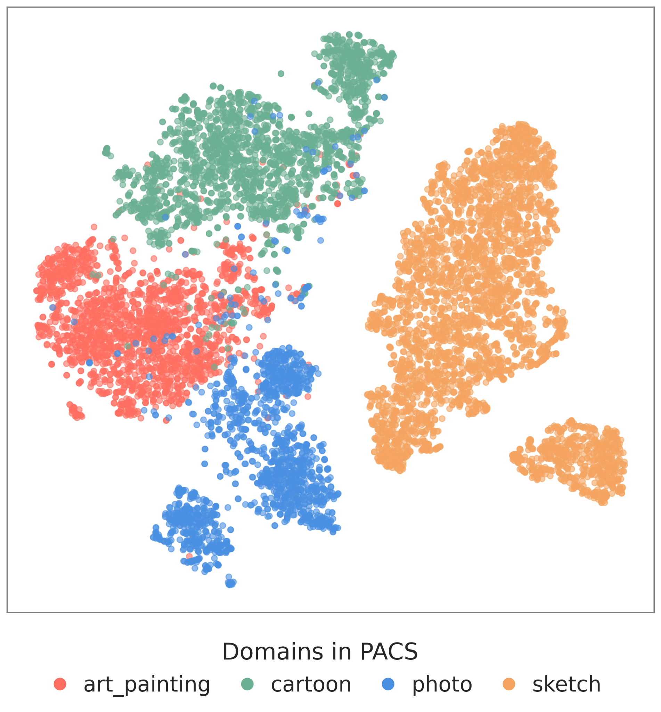
Making a diagram
What is a good diagram?
Don’t make the audience guess
What kind of images?
How are images grouped?
Points represent image embeddings

Slide 46
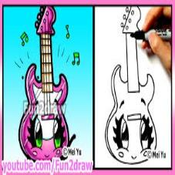
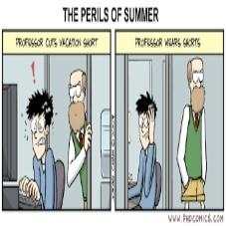
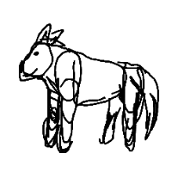
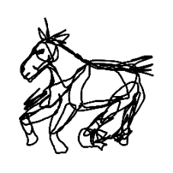
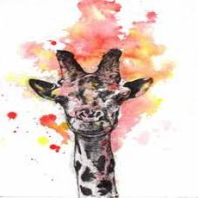
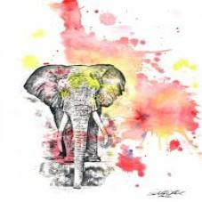

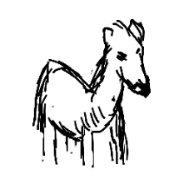
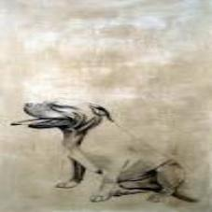
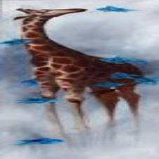
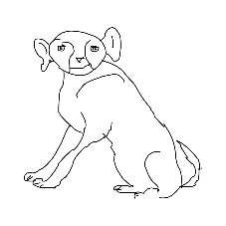
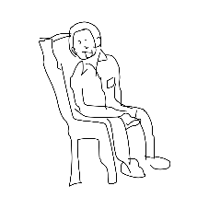

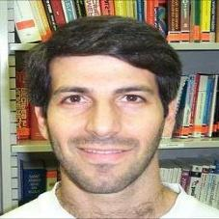
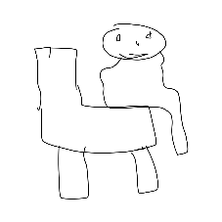
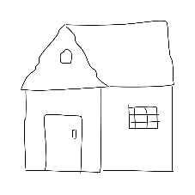
Making a diagram
What is a good diagram?
A good diagram doesn’t just show data. It shows what the data means
Points represent image embeddings

Slide 47
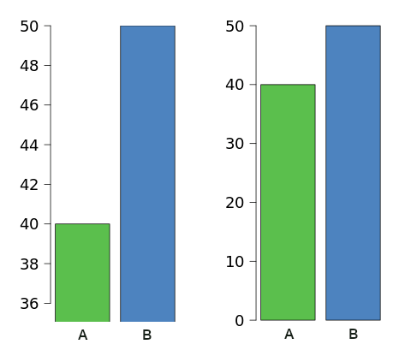
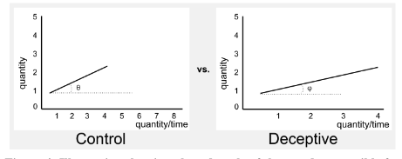
Making a diagram
A bad diagram:
Deceptive
Exaggerates differences

Slide 48
Accessibility, colorblindness
1 in 200 women and 1 in 12 men are colorblind.
Most common kind of colorblindness is red-green.
Don’t put red on top of green, or blue on top of purple, or yellow on top of light green, etc.
This is hard to distinguish:
red text on a black background is hard to read :(

Slide 49
Recap: Making Diagrams
Any tips for making diagrams?
Reduce cognitive load and thinking effort
Each diagram should answer a question
Don’t be deceptive!
Use accessible colors

Slide 50
Outline
Preparing Your Talk
Public Speaking
Presentation Design
Making Diagrams
Poster Design

Slide 51
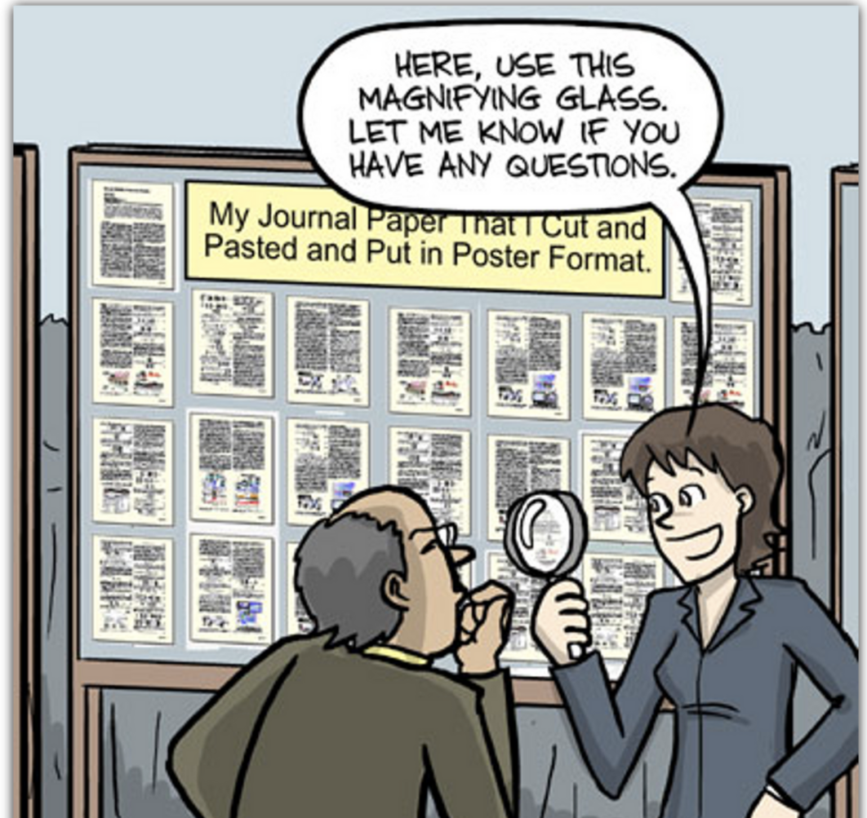
Poster Design
What is it?
Goal: NOT to replicate your paper; rather a Visual Aid
To help you make a concise 2-5 min presentation
A tool to spark conversation and convey your research

Slide 52
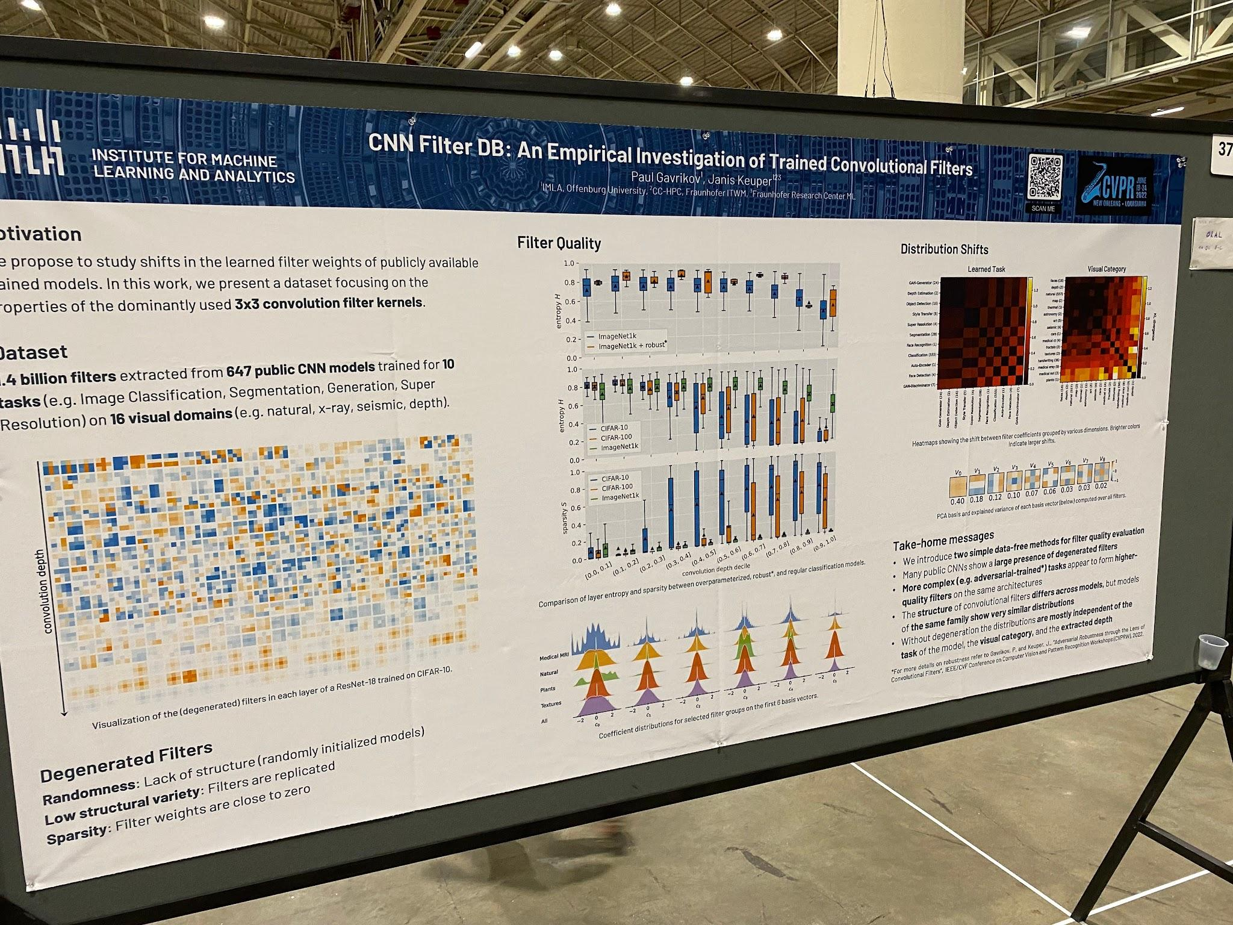
Poster Design
Do’s and Don'ts
Less Text; More Visuals
Make everything Large
Structure for scanning, not reading

Slide 53


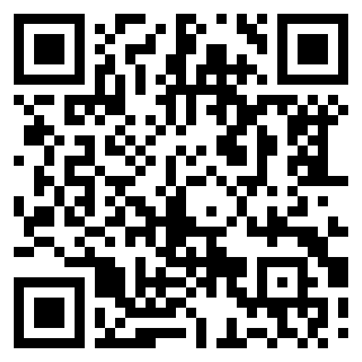

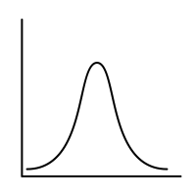

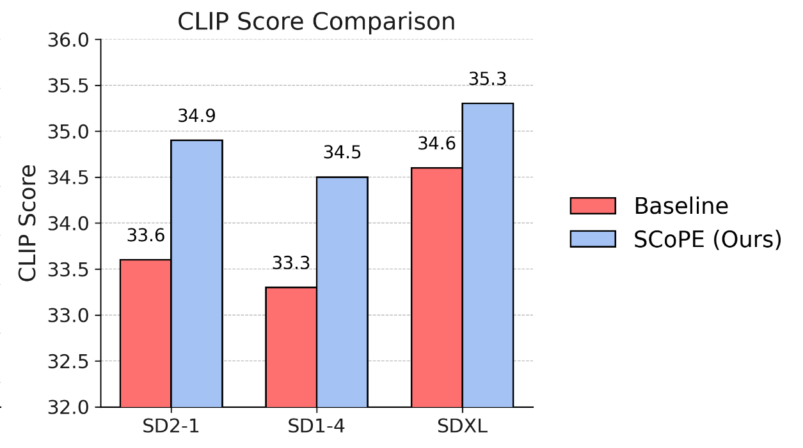

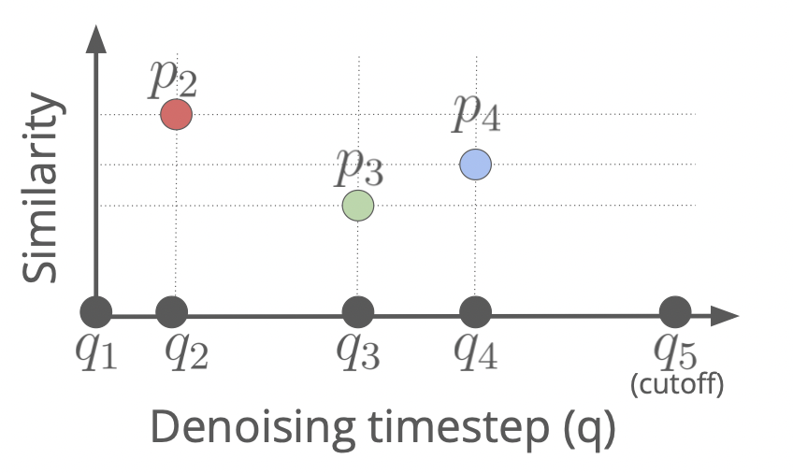




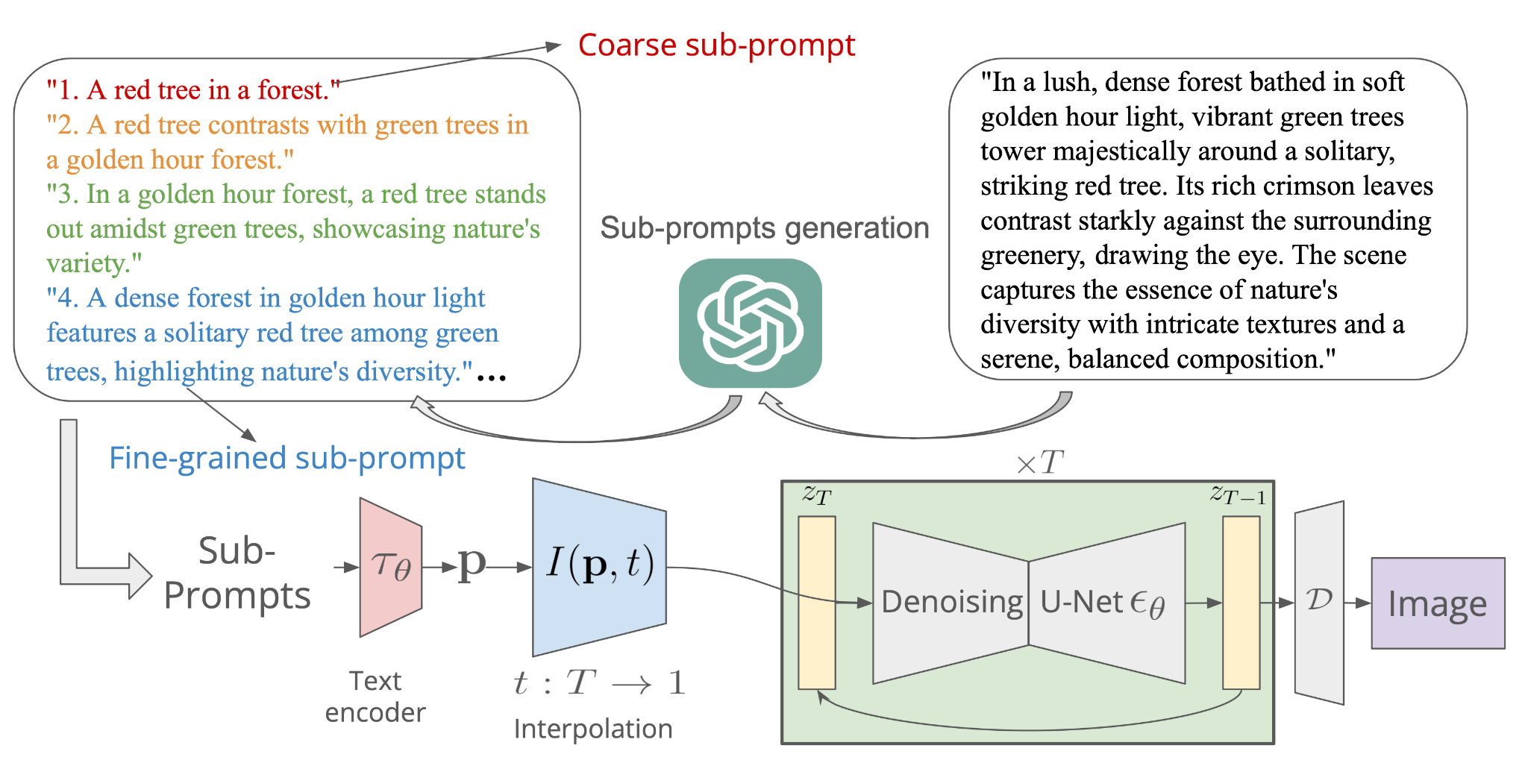
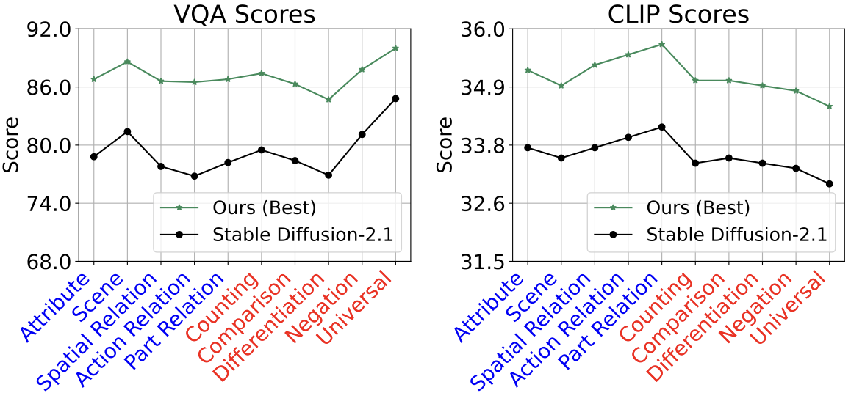
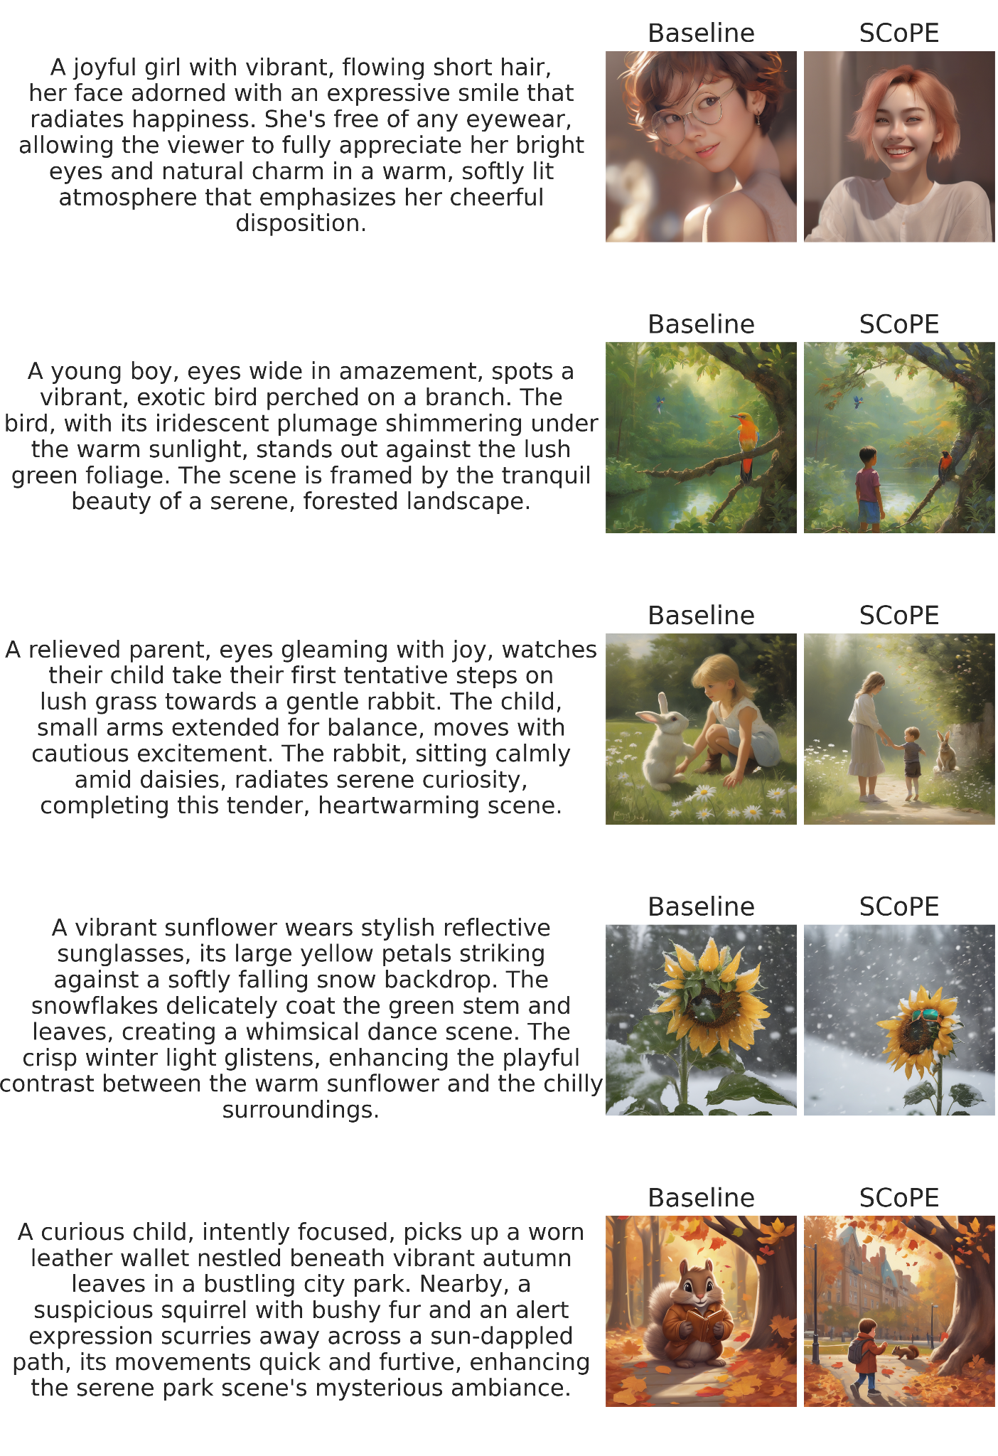
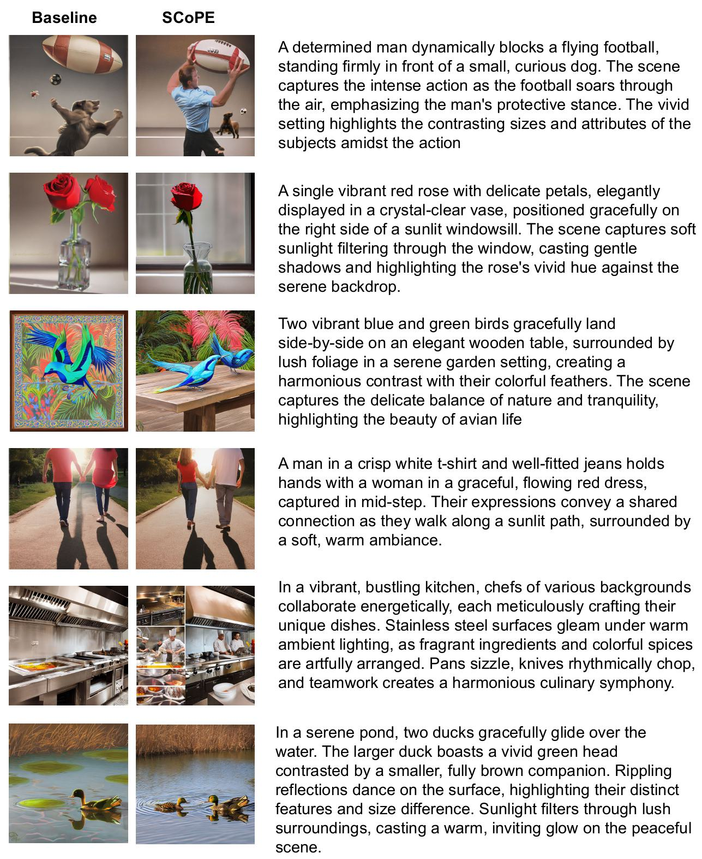
Progressive Prompt Detailing for Improved Alignment in Text-to-Image Generative Models XYZ, ABC, 123, 456 ¹Boston University, ²Johns Hopkins University, ³Runway
Project page
Motivation
Method
Quantitative Results
Problem we tackle: Text-to-image models
struggle with long, detailed prompts
often miss intricate details
Existing solutions require fine-tuning on large datasets
1) Generate sub-prompt embeddings
Dataset:
GenAI-Bench [1]: 1600 prompts, enhanced details using GPT-4o
Metrics:
CLIP-Score: Cosine similarity between prompt and image embeddings
[1] Gen-AI B
2) Assign each sub-prompt a peak influence timestep (q) and obtain interpolation weights:
Key Idea
Weights are derived from gaussians
Semantically similar sub-prompts are assigned nearby timesteps
Weights at timestep t
similarity based spacing
SCoPE: Scheduled interpolation of Coarse-to-fine Prompt Embeddings
Decompose prompt into coarse-to-fine sub-prompts
During inference, gradually interpolate sub-prompts
Sim(p2, p1)
Sim(p4, p3)
Sim(p3, p2)
Coarse sub-prompts
Fine-grained sub-prompts
Denoising timestep
q
3) Pass the interpolated embedding (i.e. weighted sum of sub-prompts) as the text-conditioning
SCoPE consistently outperforms baseline diffusion models
Qualitative Results
SCoPE is robust against different prompt tags
A joyful girl with vibrant, flowing short hair, her face adorned with an expressive smile that radiates happiness. She's free of any eyewear, allowing the viewer to fully appreciate her bright eyes and natural charm in a warm, softly lit atmosphere that emphasizes her cheerful disposition
Baseline (SDXL)
SCoPE (SDXL)
SCoPE captures more details in the image than the baseline
A relieved parent, eyes gleaming with joy, watches their child take their first tentative steps on lush grass towards a gentle rabbit. The child, small arms extended for balance, moves with cautious excitement. The rabbit, sitting calmly amid daisies, radiates serene curiosity, completing this tender, heartwarming scene
Baseline (SDXL)
SCoPE (SDXL)
[1] GenAI-Bench (Li et al., 2024); [2] VQAScore (Lin et al., 2024)
Plug-and-play, test time approach: no retraining, no model changes, model-agnostic
SCoPE adds only 0.7s of overhead per inference on an A6000 GPU
Conclusion: SCoPE
Training free
Progressively interpolates from coarse to fine grained prompts.
Improves prompt alignment by upto +8 points in VQA Score
Coarse-to-fine prompt evolution during denoising
Baseline (SD-2.1)
SCoPE (SD-2.1)
Coarse sub-prompts
A single vibrant red rose with delicate petals, elegantly displayed in a crystal-clear vase, positioned gracefully on the right side of a sunlit windowsill. The scene captures soft sunlight filtering through the window, casting gentle shadows and highlighting the rose's vivid hue against the serene backdrop
Fine-grained sub-prompts
(scene layout)
(object + spatial relations)
(object + spatial details)
t
Code and prompts available at abc.github.io
Blue: Details captured by SCoPE and missed by the baseline
Notes:
53

Slide 54
Progressive Prompt Detailing for Improved Alignment in Text-to-Image Generative Models XYZ, ABC, 123, 456 ¹Boston University, ²Johns Hopkins University, ³Runway
Project page
Motivation
Problem we tackle: Text-to-image models
struggle with long, detailed prompts
often miss intricate details
Existing solutions require fine-tuning on large datasets
Use strong visual anchors like:
Motivation
Key Idea
(easy to scan)
Draw attention to the motivation
Let visuals tell the story
Key Idea
SCoPE: Scheduled interpolation of Coarse-to-fine Prompt Embeddings
Decompose prompt into coarse-to-fine sub-prompts
During inference, gradually interpolate sub-prompts
Plug-and-play, test time approach: no retraining, no model changes, model-agnostic
Coarse-to-fine prompt evolution during denoising
Coarse sub-prompts
Fine-grained sub-prompts
(scene layout)
(object + spatial relations)
(object + spatial details)
t
Notes:
54

Slide 55
Progressive Prompt Detailing for Improved Alignment in Text-to-Image Generative Models XYZ, ABC, 123, 456 ¹Boston University, ²Johns Hopkins University, ³Runway
Project page
Method
Use strong visual anchors like:
Bolding certain words
(easy to scan) Ground abstract ideas with visuals
1) Generate sub-prompt embeddings
2) Assign each sub-prompt a peak influence timestep (q) and obtain interpolation weights:
Weights are derived from gaussians
Semantically similar sub-prompts are assigned nearby timesteps
Weights at timestep t
similarity based spacing
Sim(p2, p1)
Sim(p4, p3)
Sim(p3, p2)
Coarse sub-prompts
Fine-grained sub-prompts
Denoising timestep
q
3) Pass the interpolated embedding (i.e. weighted sum of sub-prompts) as the text-conditioning
Qualitative Results
A joyful girl with vibrant, flowing short hair, her face adorned with an expressive smile that radiates happiness. She's free of any eyewear, allowing the viewer to fully appreciate her bright eyes and natural charm in a warm, softly lit atmosphere that emphasizes her cheerful disposition
Baseline (SDXL)
SCoPE (SDXL)
Qualitative takeaways are a big bonus
Comparisons becomes immediate
Visual > Text
SCoPE captures more details in the image than the baseline
A relieved parent, eyes gleaming with joy, watches their child take their first tentative steps on lush grass towards a gentle rabbit. The child, small arms extended for balance, moves with cautious excitement. The rabbit, sitting calmly amid daisies, radiates serene curiosity, completing this tender, heartwarming scene
Baseline (SDXL)
SCoPE (SDXL)
SCoPE adds only 0.7s of overhead per inference on an A6000 GPU
A single vibrant red rose with delicate petals, elegantly displayed in a crystal-clear vase, positioned gracefully on the right side of a sunlit windowsill. The scene captures soft sunlight filtering through the window, casting gentle shadows and highlighting the rose's vivid hue against the serene backdrop
Baseline (SD-2.1)
SCoPE (SD-2.1)
Blue: Details captured by SCoPE and missed by the baseline
Notes:
55

Slide 56
Progressive Prompt Detailing for Improved Alignment in Text-to-Image Generative Models XYZ, ABC, 123, 456 ¹Boston University, ²Johns Hopkins University, ³Runway
Project page
Quantitative Results
Charts/Plots >> Tables
Tersely but clearly define the setting (i.e., dataset, metric, etc.)
Highlight your results! – Takeaways & Conclusions
Dataset:
GenAI-Bench [1]: 1600 prompts, enhanced details using GPT-4o
Metrics:
CLIP-Score: Cosine similarity between prompt and image embeddings
[1] Gen-AI B
SCoPE consistently outperforms baseline diffusion models
SCoPE is robust against different prompt tags
Include a project page / code link for people to checkout the paper / code And a way to get your contact details
[1] GenAI-Bench (Li et al., 2024); [2] VQAScore (Lin et al., 2024)
Conclusion: SCoPE
Training free
Progressively interpolates from coarse to fine grained prompts.
Improves prompt alignment by upto +8 points in VQA Score
Code and prompts available at abc.github.io
Notes:
56

Slide 57
Poster Presentation
What to expect?
Do NOT assume people will read everything
You will find yourself repeating a lot of things
Use the poster as a visual aid, not a script
People will join mid-explanation
Get ready to start again
Some visitors may just look and move on

Slide 58
Poster Presentation
Before, During, After
Prepare a 30-second and 2-minute pitch
Look welcoming
Face the incoming wave of people
Do not turn and stare at your poster

Slide 59
Poster Presentation
Before, During, After
Be the person to break the ice, “Would you like a quick overview?”
Point to visuals and results on your poster
Adapt depth based on interest

Slide 60
Poster Presentation
Before, During, After
Offer the QR code / project page link
Ask if they have any questions / suggestions – invite a discussion
Note feedback for improving the work
Connect, exchange contacts, keep in touch

Slide 61
Recap: Poster Design & Presentations
Any tips for poster design & presentations?
Visual aid for your paper
Structure for scanning, not reading
Use visual anchors (e.g. bolding), figures, charts
During presentations, look welcoming and offer an overview. Be nice :)

Slide 62
Thank you!

